Slide 1
Code User Management Module
Task List:
Code UserDAO + Unit tests
Implement List Users feature
Implement Create User feature
Implement Edit User feature
Implement Delete User feature

Slide 2
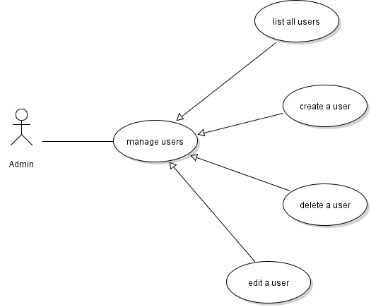
User Management Use Cases

Slide 3
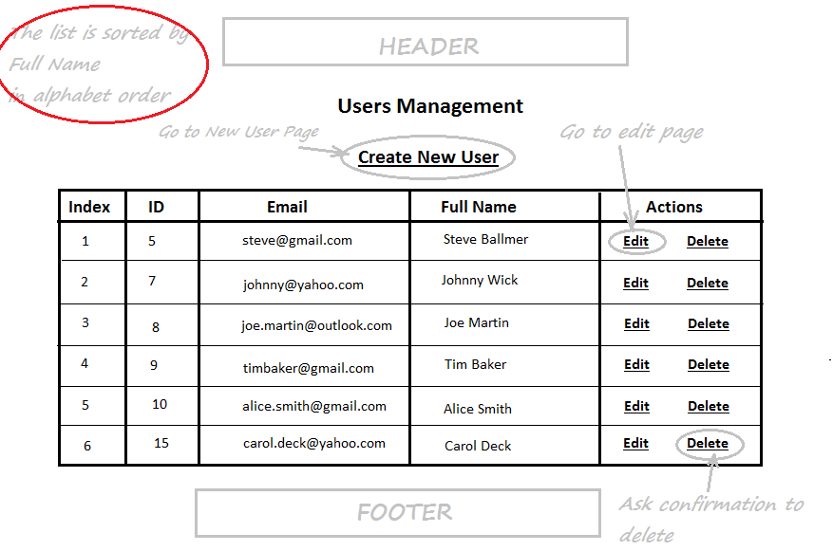
Users List Page

Slide 4
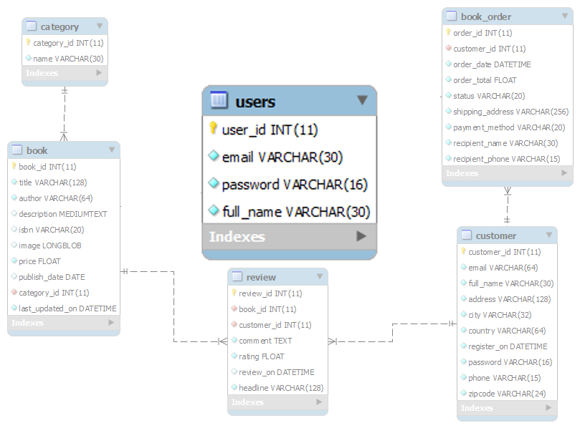
Database Design – Table users

Slide 5
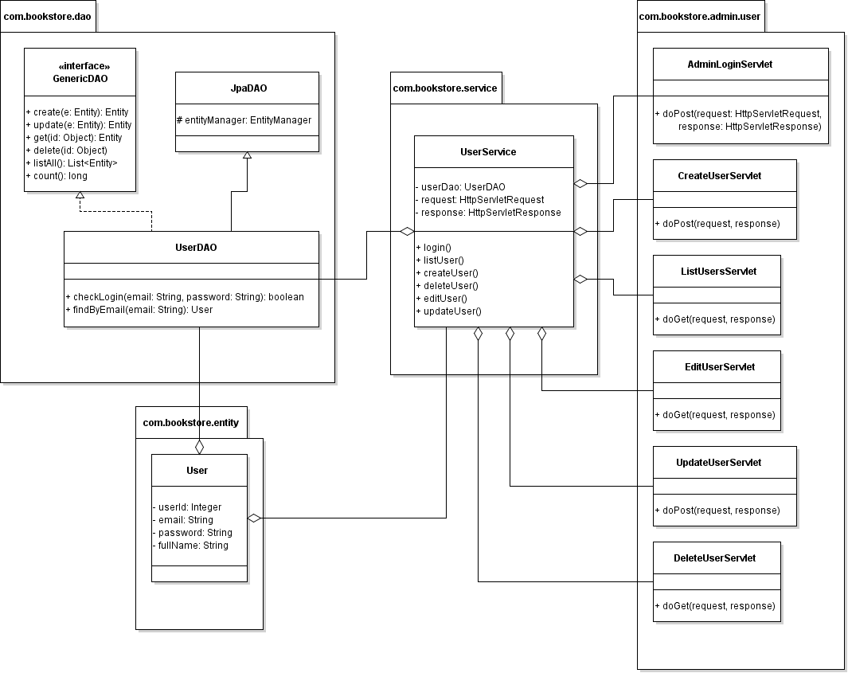
Class Diagram

Slide 6
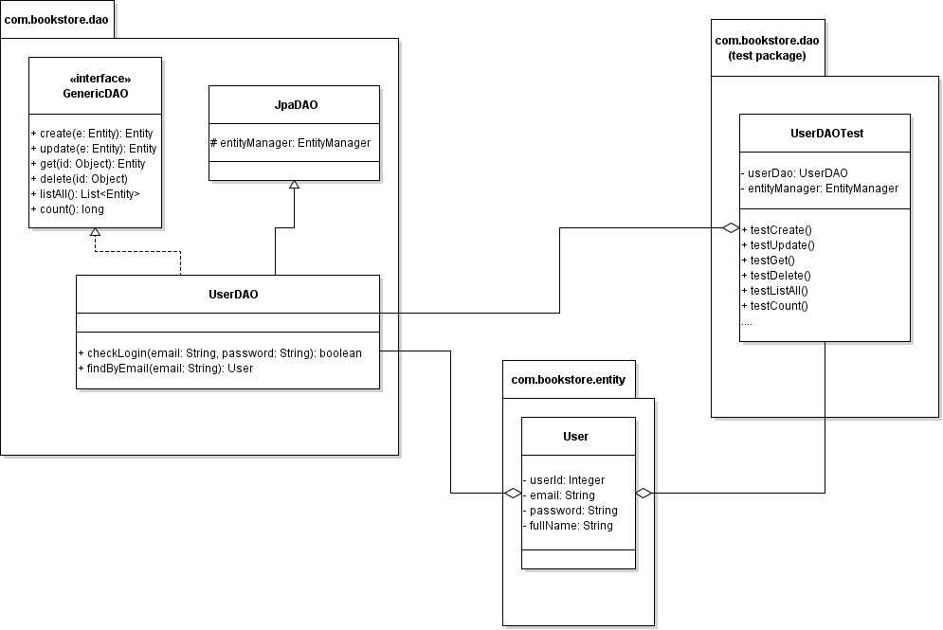
Code UserDAO

Slide 7
Implement List Users feature
Code ListUsersServlet
Code UserService
Code User List Page (HTML + JSTL)

Slide 8
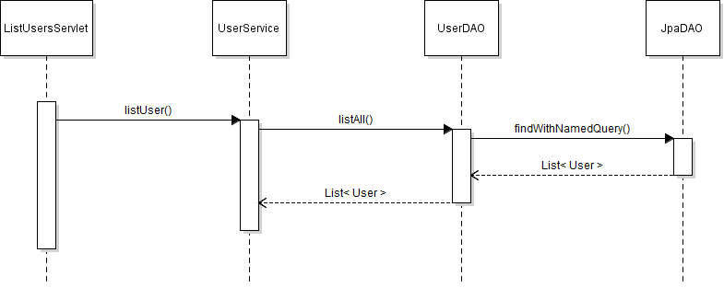
List Users Sequence Diagram

Slide 9
Users List Page

Slide 10
Implement Create User Feature
Code User Form Page (JSP)
Validate Input in User Form (Javascript)
Code Servlet Class (CreateUserServlet)
Update UserServices Class
Code Message Page (JSP)

Slide 11
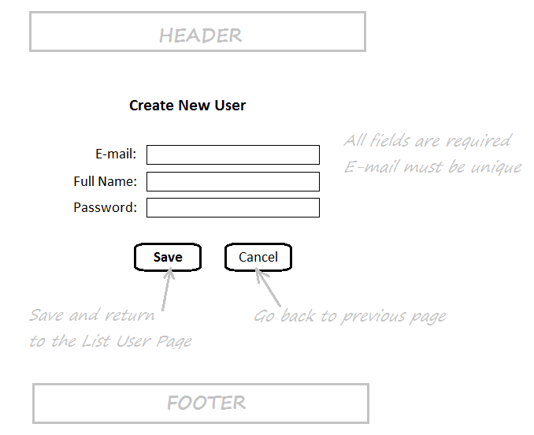
User Form Page

Slide 12
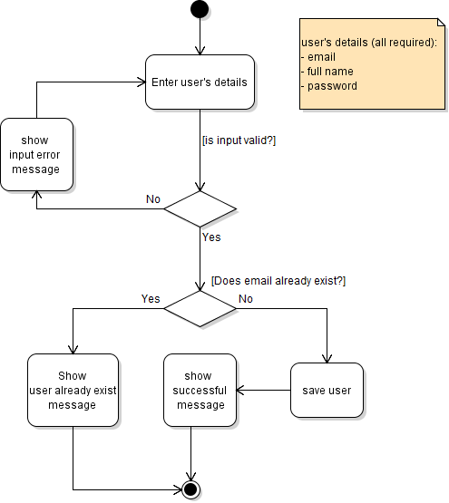
Activity Diagram: Create User

Slide 13
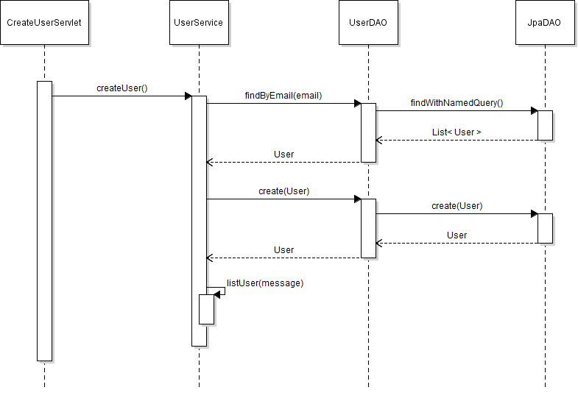
Sequence Diagram: Create User

Slide 14
Implement Edit User Feature
Create EditUserServlet Class
Update User Form Page (JSP)
Create UpdateUserServlet
Update UserServices Class

Slide 15
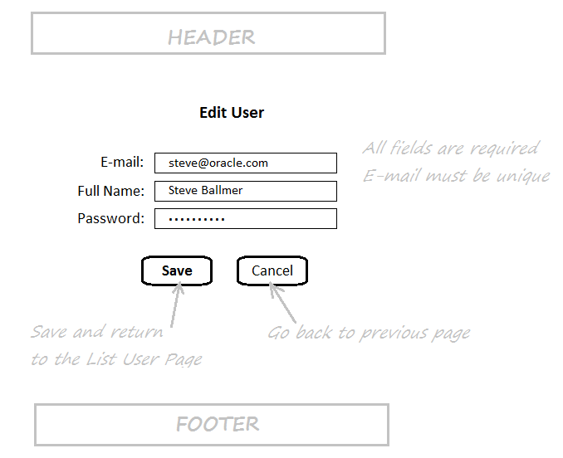
User Form in Edit mode

Slide 16
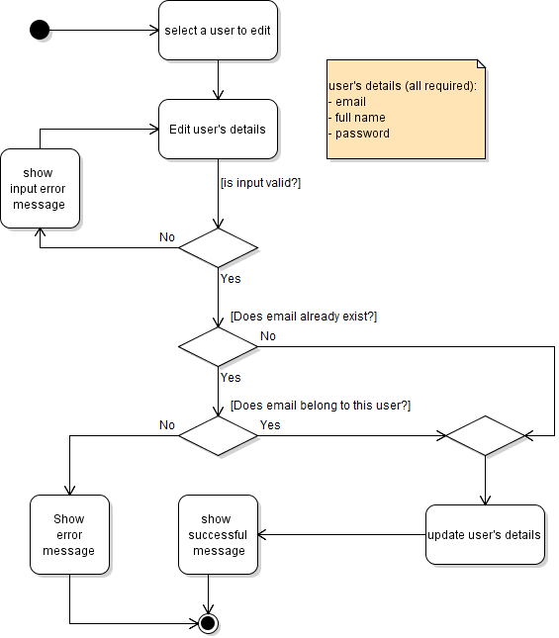
Activity Diagram: Update User

Slide 17
Class Diagram

Slide 18
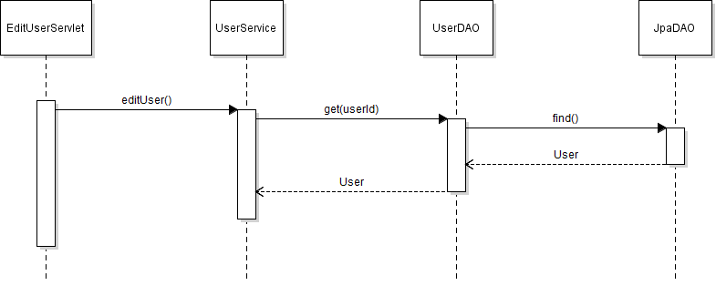
Sequence Diagram: Edit User

Slide 19
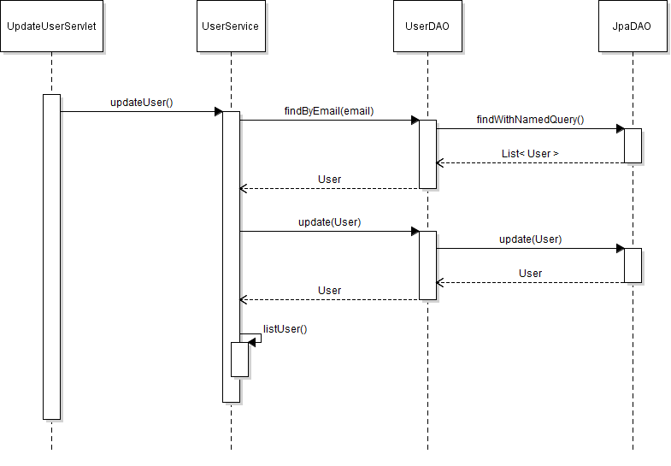
Sequence Diagram: Update User

Slide 20
Implement Delete User Feature
Show Delete Confirmation Dialog
Create DeleteUserServlet
Update UserServices Class

Slide 21
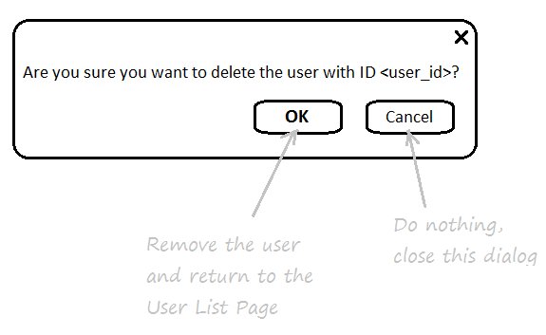
Delete User Confirmation Dialog

Slide 22
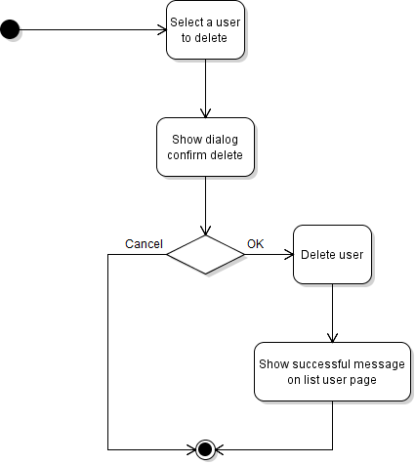
Activity Diagram: Delete User

Slide 23
Class Diagram:

Slide 24
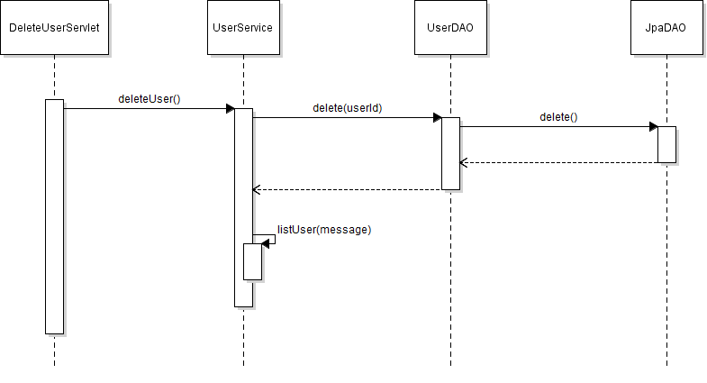
Sequence Diagram:

